Slide 1

PASSWORD BASED DOOR LOCKING SYSTEM
EE PROJECT BY TEAM 7

Slide 2
OBJECTIVES
TO MAKE A DIGITAL PASSWORD BASED DOOR LOCK WHICH IS A QUITE REQUIRED SYSTEM FOR SECURITY THESE DAYS
TO NOT MAKE THE SYSTEM COSTLY SO THAT IT CAN REACH OUT AND HELP EVERYONE WHILE ALSO TAKING CARE OF THE EFFECTIVE SECURITY
TO SOLVE THE PROBLEM OF FORGETING KEYS AND MAKE THE KEY HUSTLE DISAPPEAR
TO MAKE IT EASY TO USE BUT ALSO SECURE IT FROM HACKING
TO HAVE A CAMERA TO RECORD THINGS GOING ON TO PROVIDE EXTRA SECURITY
TO HAVE A THERMAL CAMERA TO HAVE MOTION DETECTION
THE USER SHOULD ALSO CONNECT TO THE LOCK FROM LONG DISTANCES
IT SHOULD BE USER FRIENDLY BUT AT THE SAME TIME BE FAST, SECURE AND PROTECTIVE
IT SHOULD BE AVAILABLE WITH AN EXTRA KEY IN CASE ANYONE FORGETS THE PASSCODE
IT SHOULD ALSO WORK IN CASE OF A POWER FALURE

Slide 3
REQUIREMENTS
THE LOCK SHOULD HAVE AN NFC TAG TO BE USER FRIENDLY
THE LOCK SHOULD HAVE A TEMPERORY KEY
THE LOCK SHOULD HAVE A FULL HD CAMERA
THE LOCK SHOULD HAVE INFRARED MOTION DETECTORS (PIR)
THE LOCK SHOULD ALSO BE PRESENT WITH WIFI CONNECTIVITY SO AS TO INCREASE THE RANGE OF CONNECTIVITY BETWEEN THE USER AND THE LOCK
THE LOCK SHOULD HAVE A REMOTE CONTROL SO THAT THE BATTERY DOESN’T RUN OUT FASTER

Slide 4
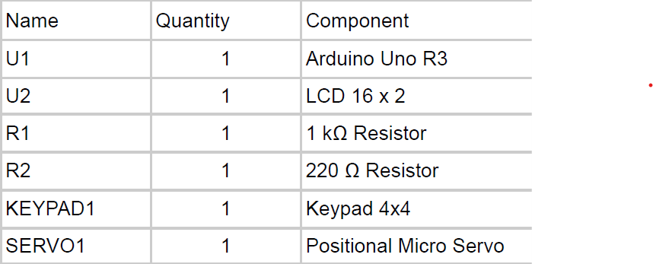
COMPONENTS NEEDED FOR IMPLANTATION

Slide 5
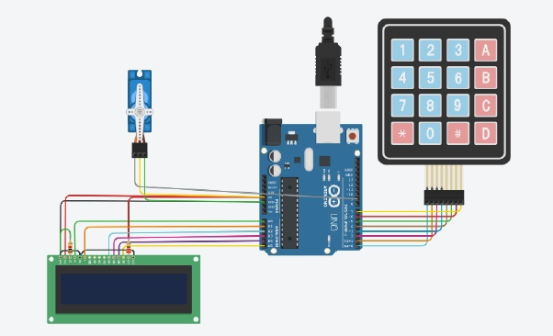
CIRCUIT DAIGRAM

Slide 6
CODE
void clearData()
{
while (data_count != 0)
{
Data[data_count--] = 0;
}
return;
}
void ServoClose()
{
for (pos = 90; pos >= 0; pos -= 10) {
myservo.write(pos);
}
}
void ServoOpen()
{
for (pos = 0; pos <= 90; pos += 10) {
myservo.write(pos);
}
}
void Open()
{
lcd.setCursor(0, 0);
lcd.print("Enter Password");
customKey = customKeypad.getKey();
if (customKey)
{
Data[data_count] = customKey;
lcd.setCursor(data_count, 1);
lcd.print(Data[data_count]);
data_count++;
}
#include <Keypad.h>
#include <LiquidCrystal.h>
#include <Servo.h>
#define Password_Length 5
Servo myservo;
LiquidCrystal lcd(A0, A1, A2, A3, A4, A5);
int pos = 0;
char Data[Password_Length];
char Master[Password_Length] = "1234";
byte data_count = 0, master_count = 0;
bool Pass_is_good;
bool door = false;
char customKey;
/---preparing keypad---/
const byte ROWS = 4;
const byte COLS = 4;
char keys[ROWS][COLS] = {
{'1', '2', '3', 'A'},
{'4', '5', '6', 'B'},
{'7', '8', '9', 'C'},
{'*', '0', '#', 'D'}
};
byte rowPins[ROWS] = {0, 1, 2, 3};
byte colPins[COLS] = {4, 5, 6, 7};
Keypad customKeypad( makeKeymap(keys), rowPins, colPins, ROWS, COLS);
/--- Main Action ---/
void setup()
{
myservo.attach(9, 2000, 2400);
ServoClose();
lcd.begin(16, 2);
lcd.print("Protected Door");
loading("Loading");
lcd.clear();
}
void loop()
{
if (door == true)
{
customKey = customKeypad.getKey();
if (customKey == '#')
{
lcd.clear();
ServoClose();
lcd.print("Door is closed");
delay(3000);
door = false;
}
}
else
Open();
}
void loading (char msg[]) {
lcd.setCursor(0, 1);
lcd.print(msg);
for (int i = 0; i < 9; i++) {
delay(1000);
lcd.print(".");}}
if (data_count == Password_Length - 1)
{
if (!strcmp(Data, Master))
{
lcd.clear();
ServoOpen();
lcd.print(" Door is Open ");
door = true;
delay(5000);
loading("Waiting");
lcd.clear();
lcd.print(" Time is up! ");
delay(1000);
ServoClose();
door = false;
}
else
{
lcd.clear();
lcd.print(" Wrong Password ");
door = false;
}
delay(1000);
lcd.clear();
clearData();

Slide 7
FINAL PRODUCT DESCRIPTION
A DIGITAL PASSWORD BASED DOOR LOCK WHICH IS A QUITE REQUIRED SYSTEM FOR SECURITY THESE DAYS
IT IS AVAILABLE AT A VERY AFFORDABLE PRICE TO REACH OUT TO EVERYONE EASILY
THE PROBLEM OF FORGETTING KEYS IS NOW SORTED BECAUSE THE KEY HUSTLE JUST DISSAPEARS AS THIS SIMPLE AND SECURE SYSTEM ARRIVES
IT IS A SIMPLE MOBILE APPLICATION WHICH GRANTS A TEMPORARY KEY TO THE USER ON THE APPLICATION ON AND FOR A SPECIFIC TIME HENCE IT HIS SECURED FROM HACKING AS WELL
IT RECORDS EVERYTHING HAPPENING IN FRONT OF IT AND ALSO THE INFRARED MOTION DETECTORS DETECT ANY KIND OF INFRARED ENERGY SURGE WHICH IS MOVEMENT DETECTION IN EASY WORDS
THE USAGE OF WIFI ALSO ENABLES THE TRANSFER OF COMMANDS FROM LONG DISTANCES AS WELL
AN NFC TAG IS USED SO THAT THE SYSTEM RESPONDS WHEN WE PASS THE PHONE NEAR THE DOOR
A REMOTE CONTROL IS USED SO THAT THE BATTERY DOESN’T RUN OUT FASTER AND THE LOCK IS STILL WORKING EVEN IN THE CASE OF A POWER FAILURE
IT IS ALSO AVAILABLE WITH AN EXTRA PASSCODE SET BY THE USER IN CASE HE/SHE FORGETS THE PHONE
IT IS A USER FRIENDLY BUT AT THE SAME TIME BE FAST, SECURE AND THE MOST PROTECTIVE AND SMART DOOR LOCK

Slide 8
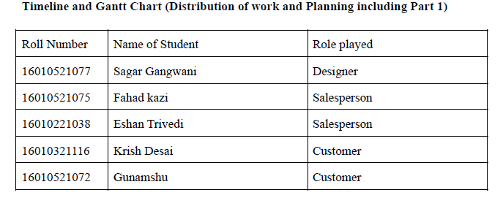
EE PROJECT BY TEAM 7

